Slide 1
Lesson objective
Need calculators and whiteboards.
Tittle: Volume and capacity
Aim – be able to:
Convert units of volume and capacity
Calculate volume of solids
Plan:
Review cross-sections
Conversions

Slide 2
Fill in the blanks
Volume is the amount of space contained or taken up by a 3-_________ object. Volume can be determined by calculating the area of the _____________ (or face) and ___________ it by the ______ of the prism.
Multiplying cross-section Dimensional length

Slide 3
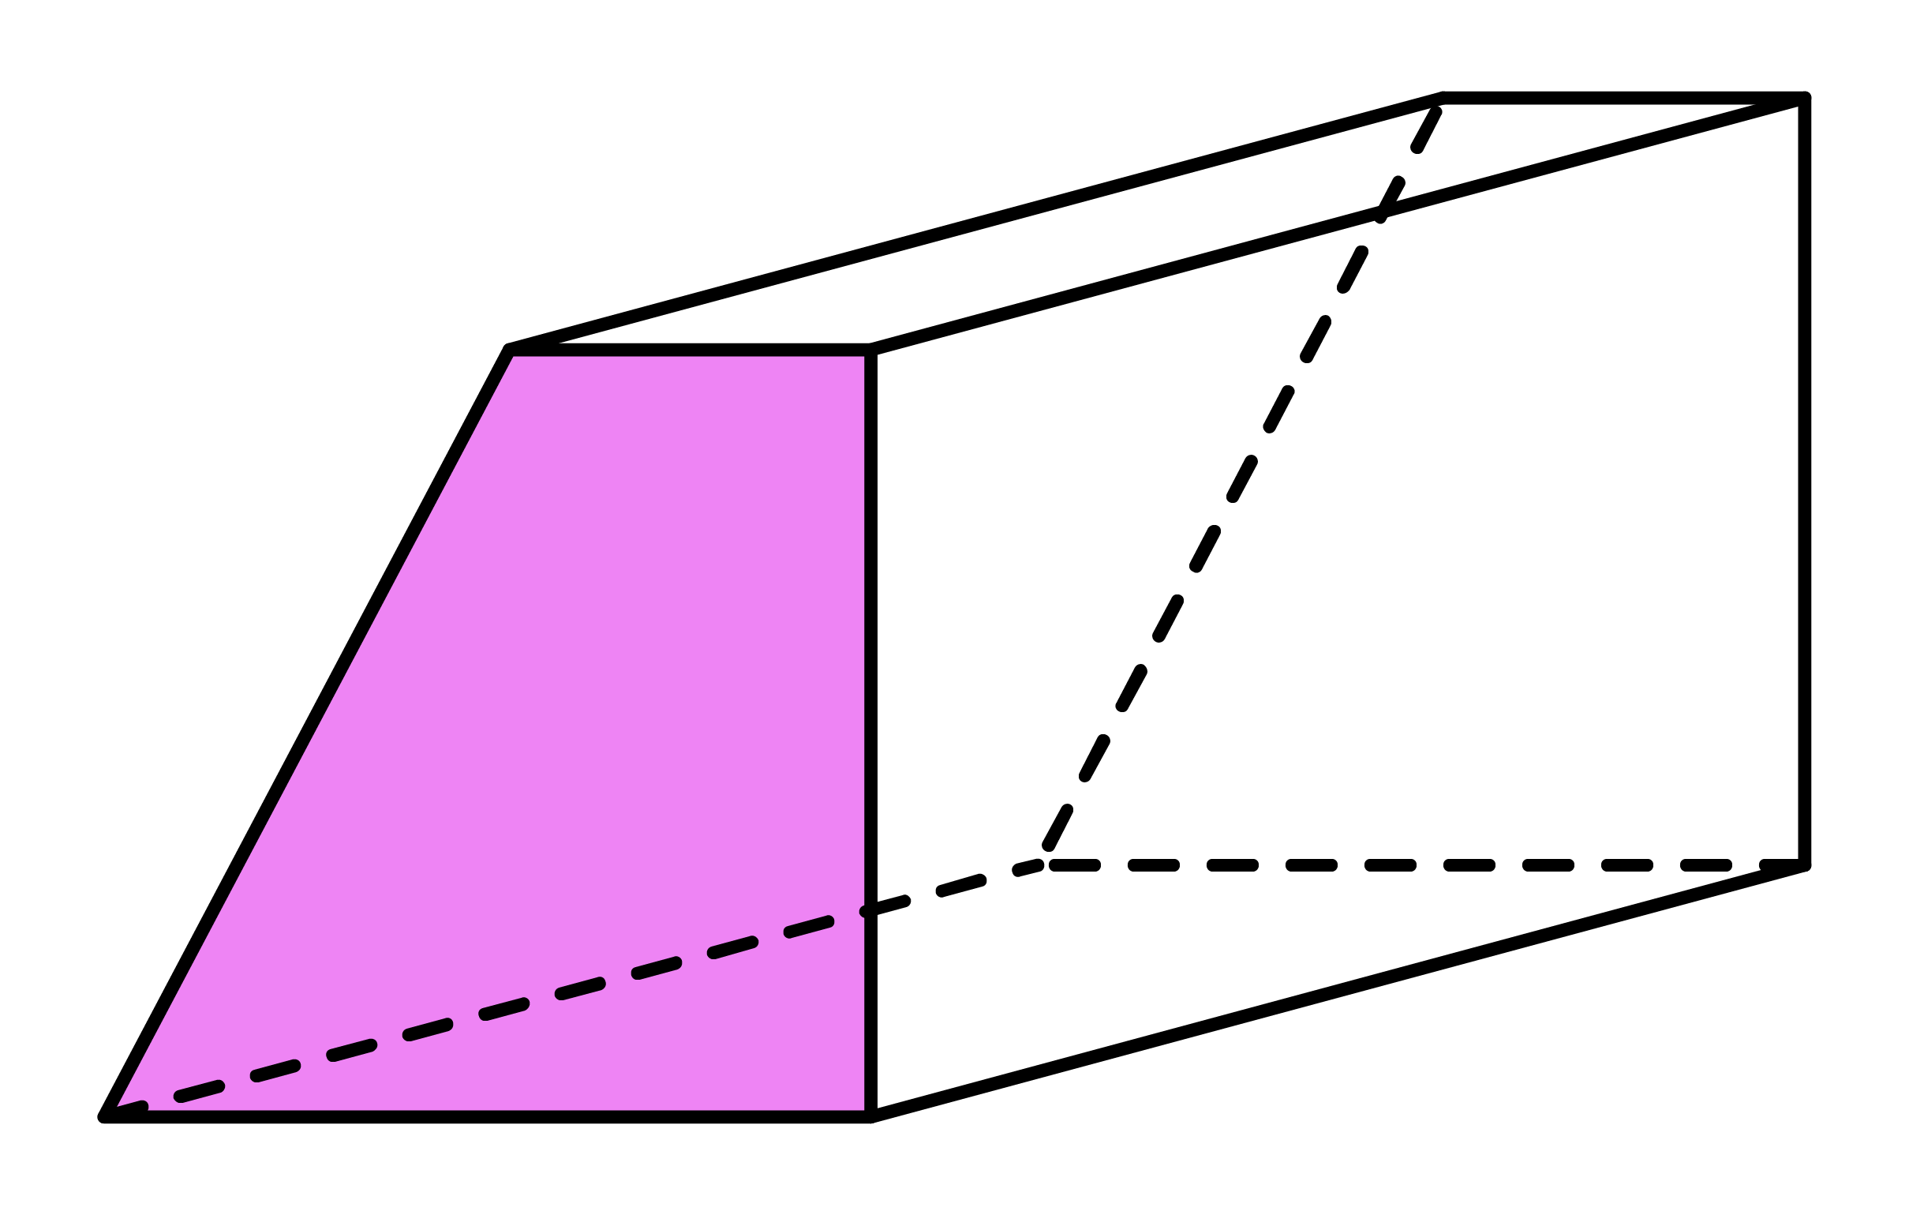
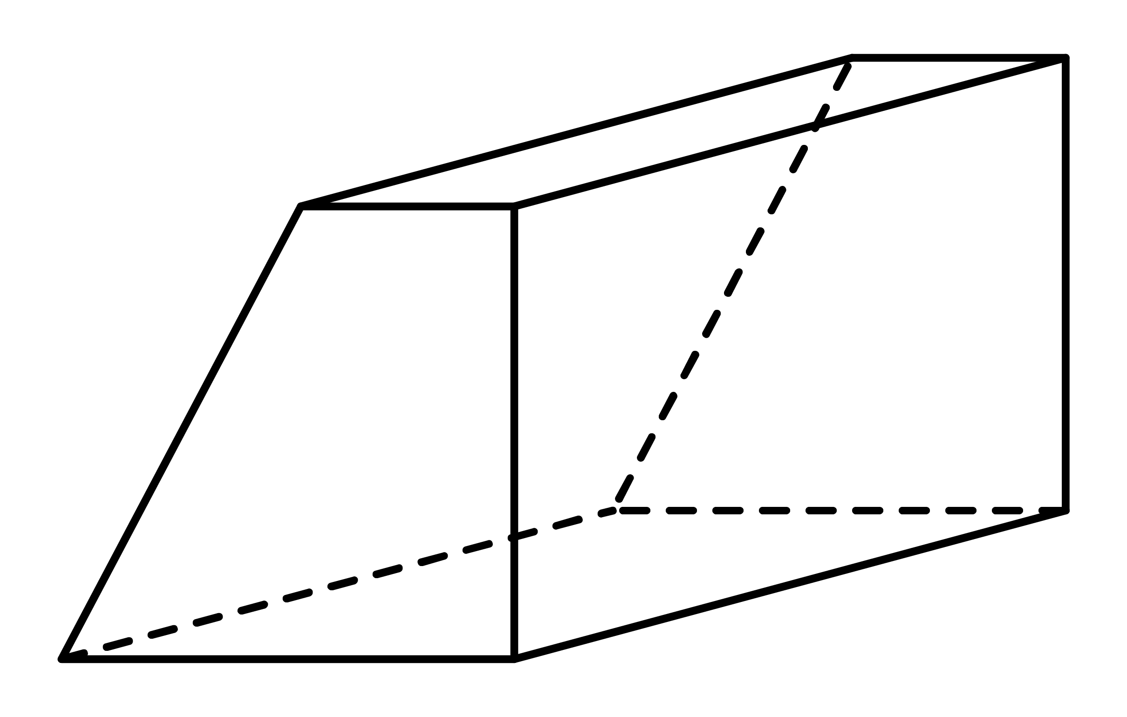
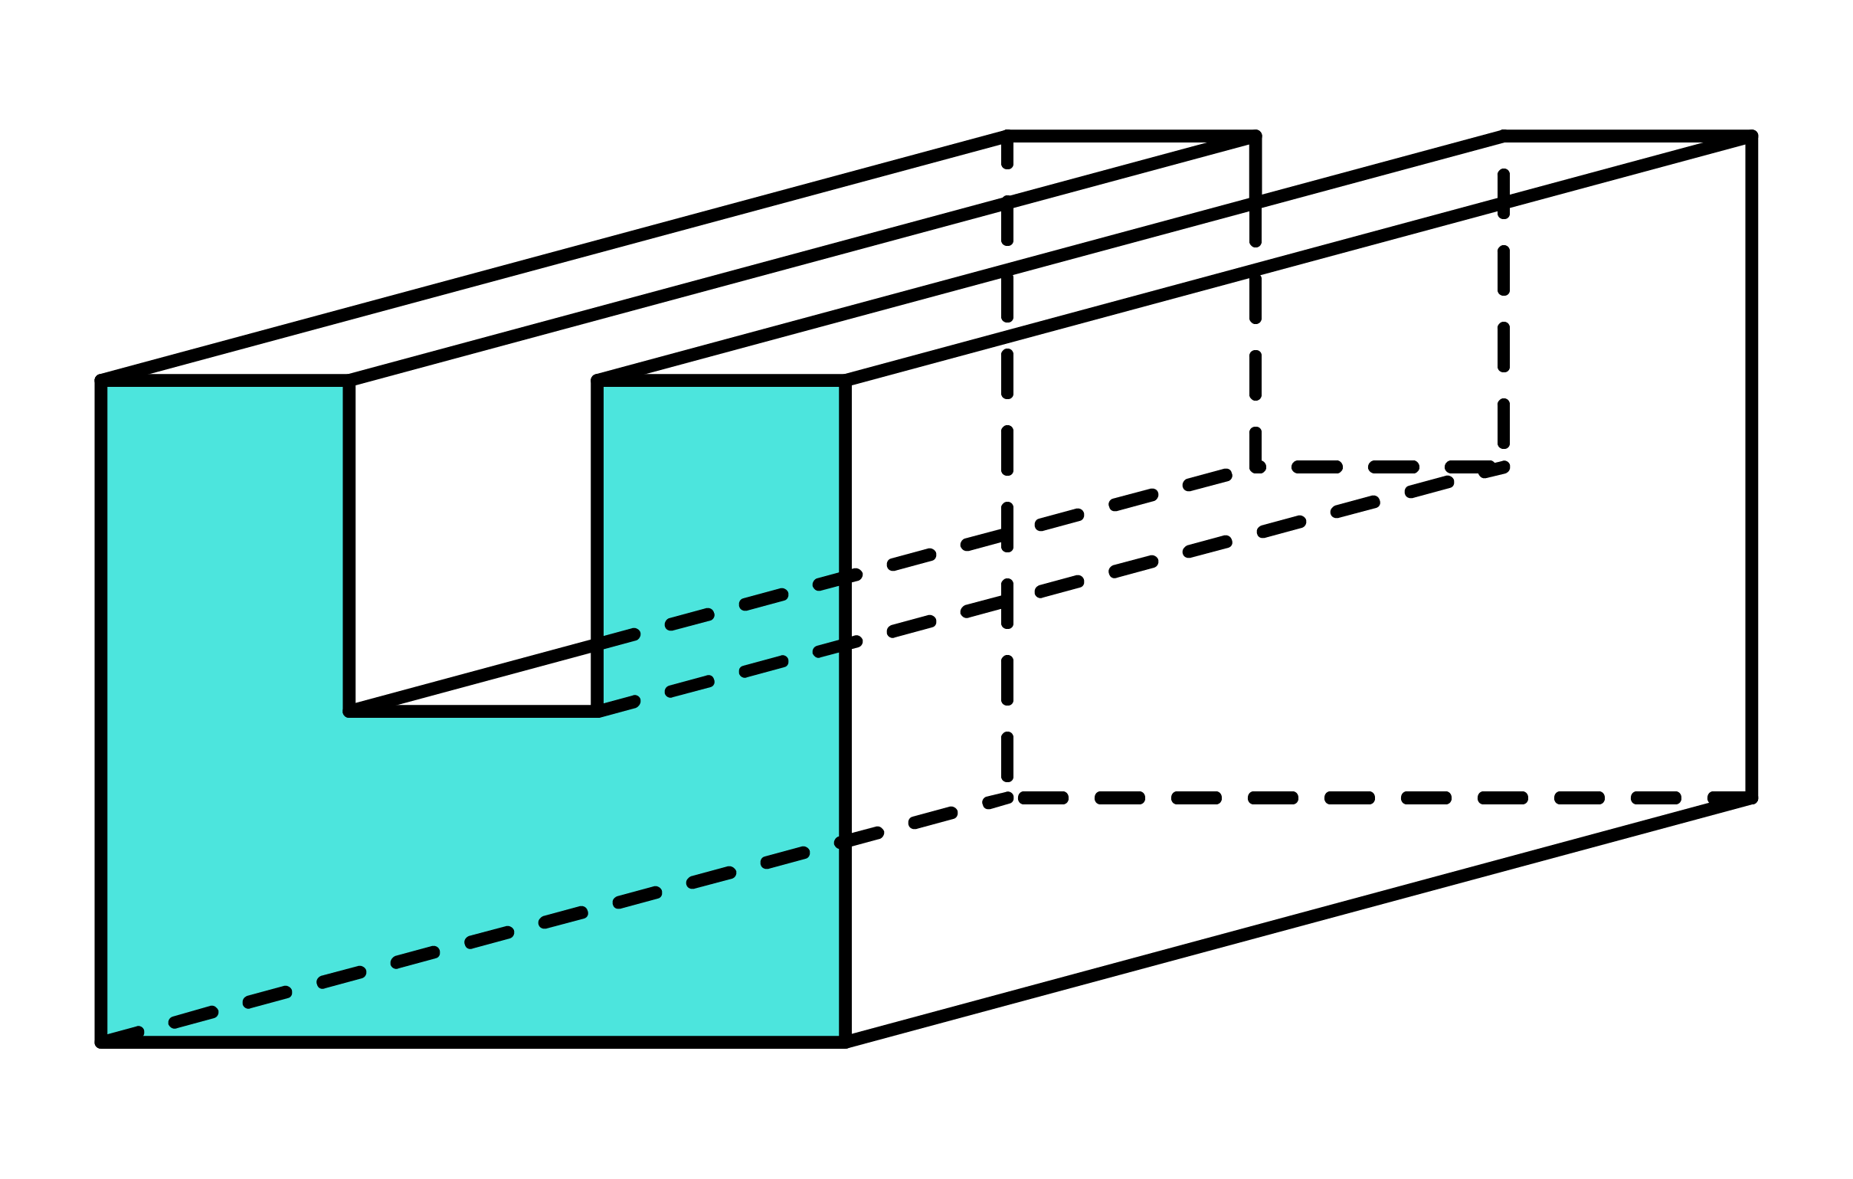
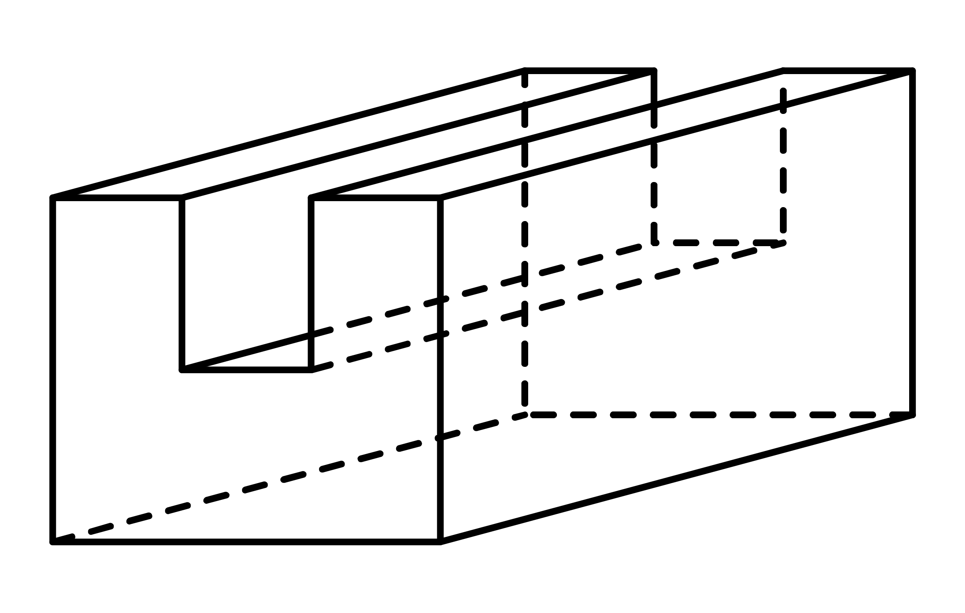
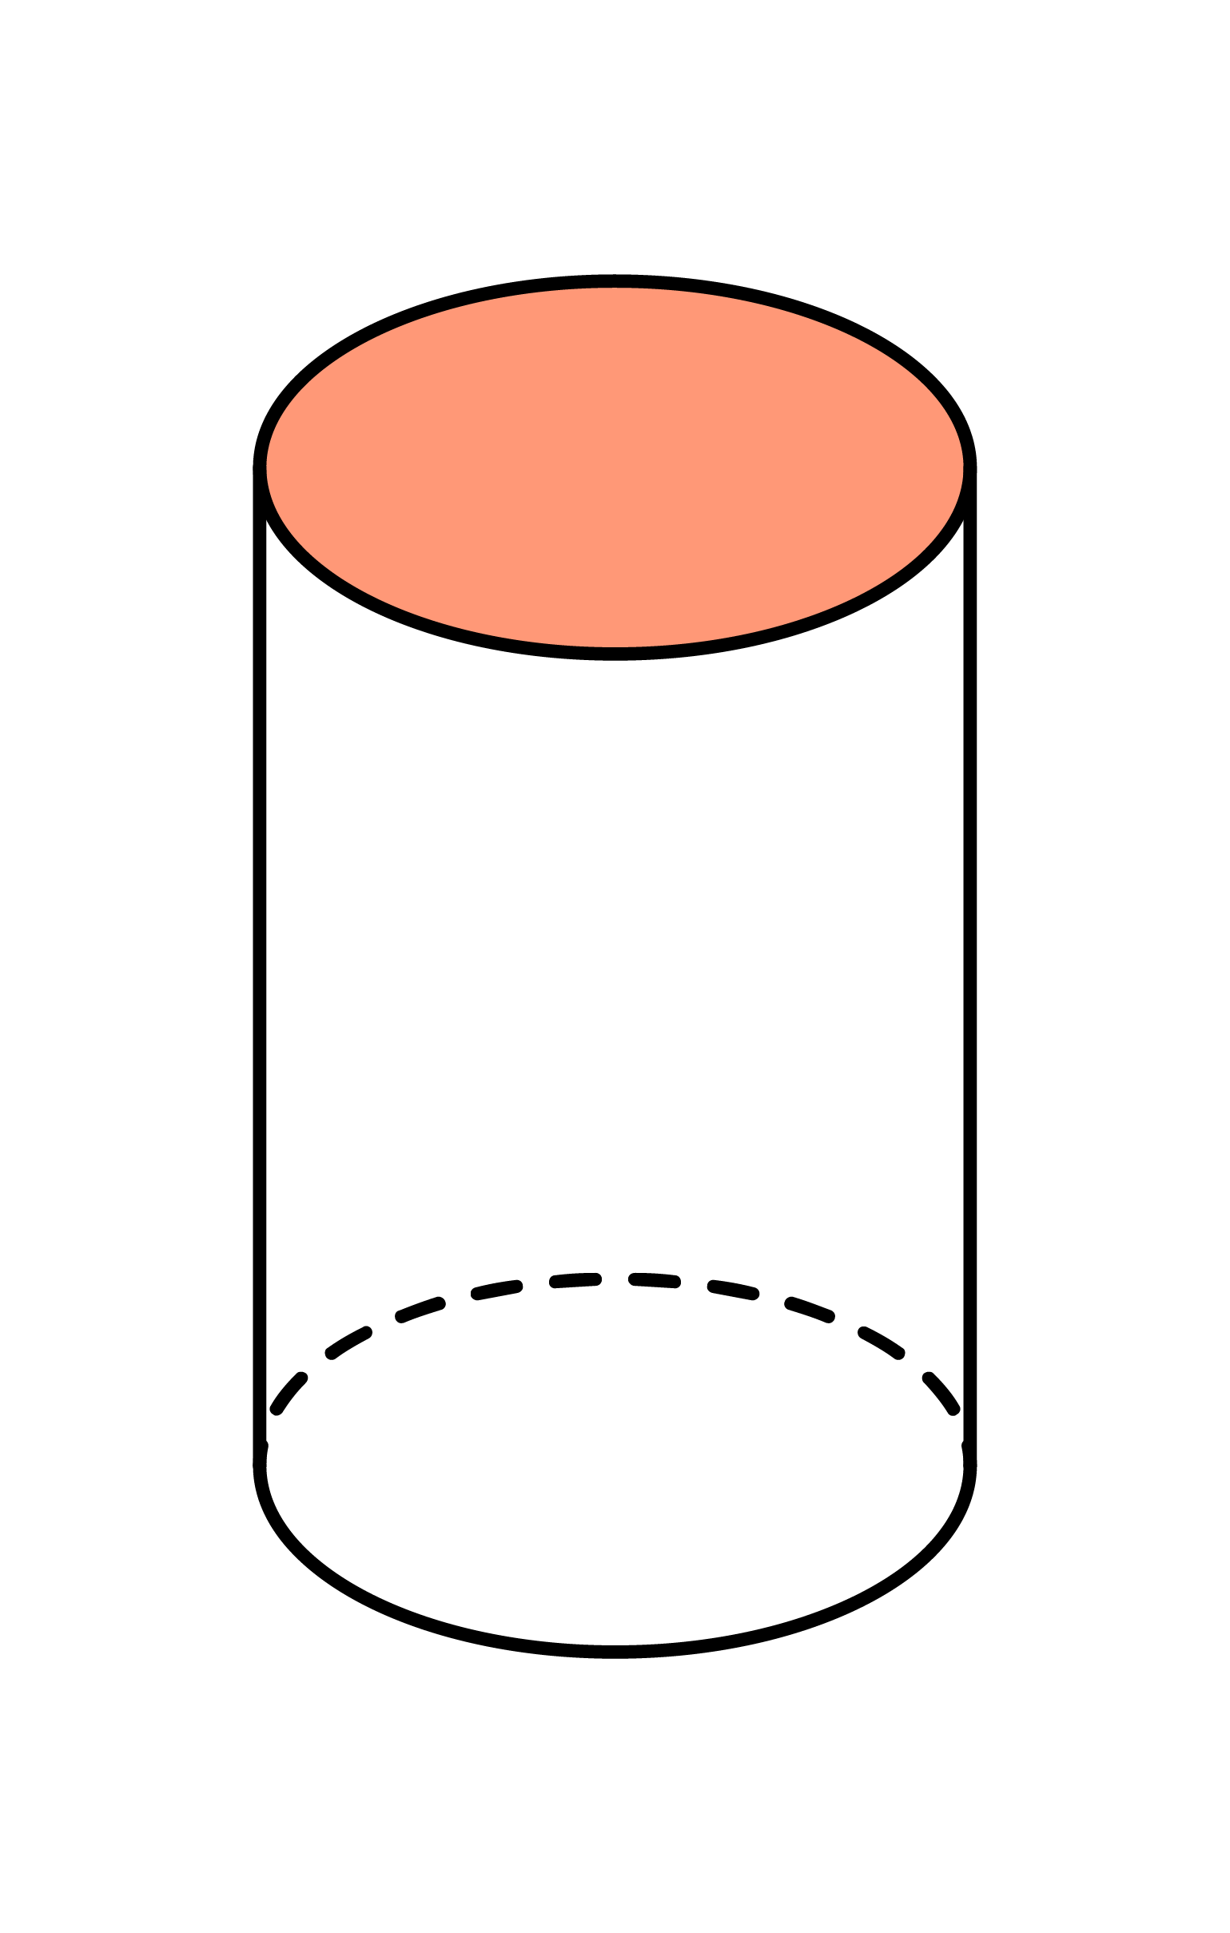
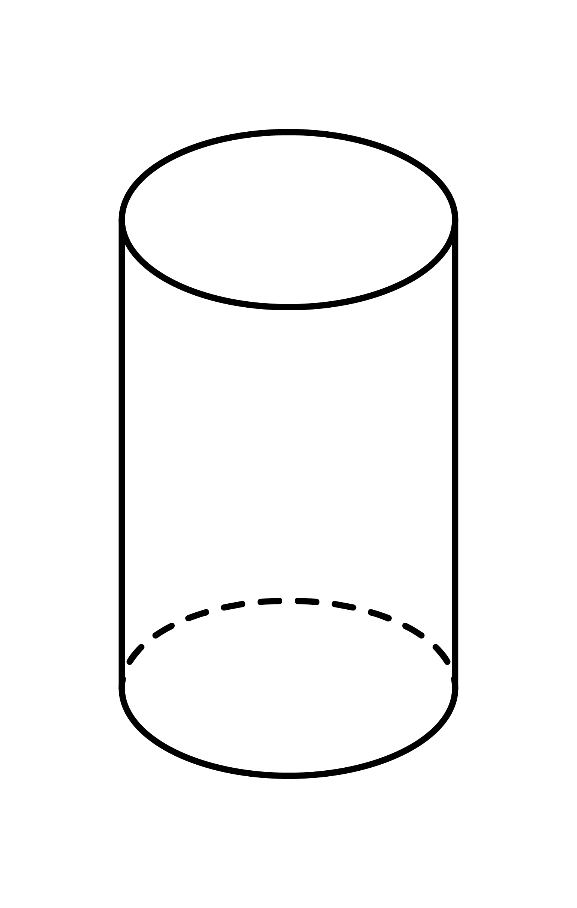
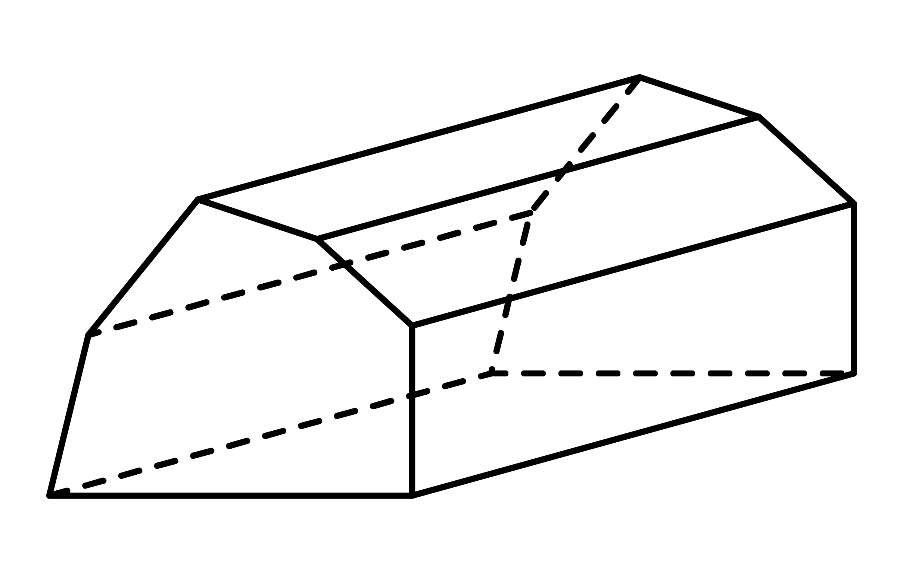
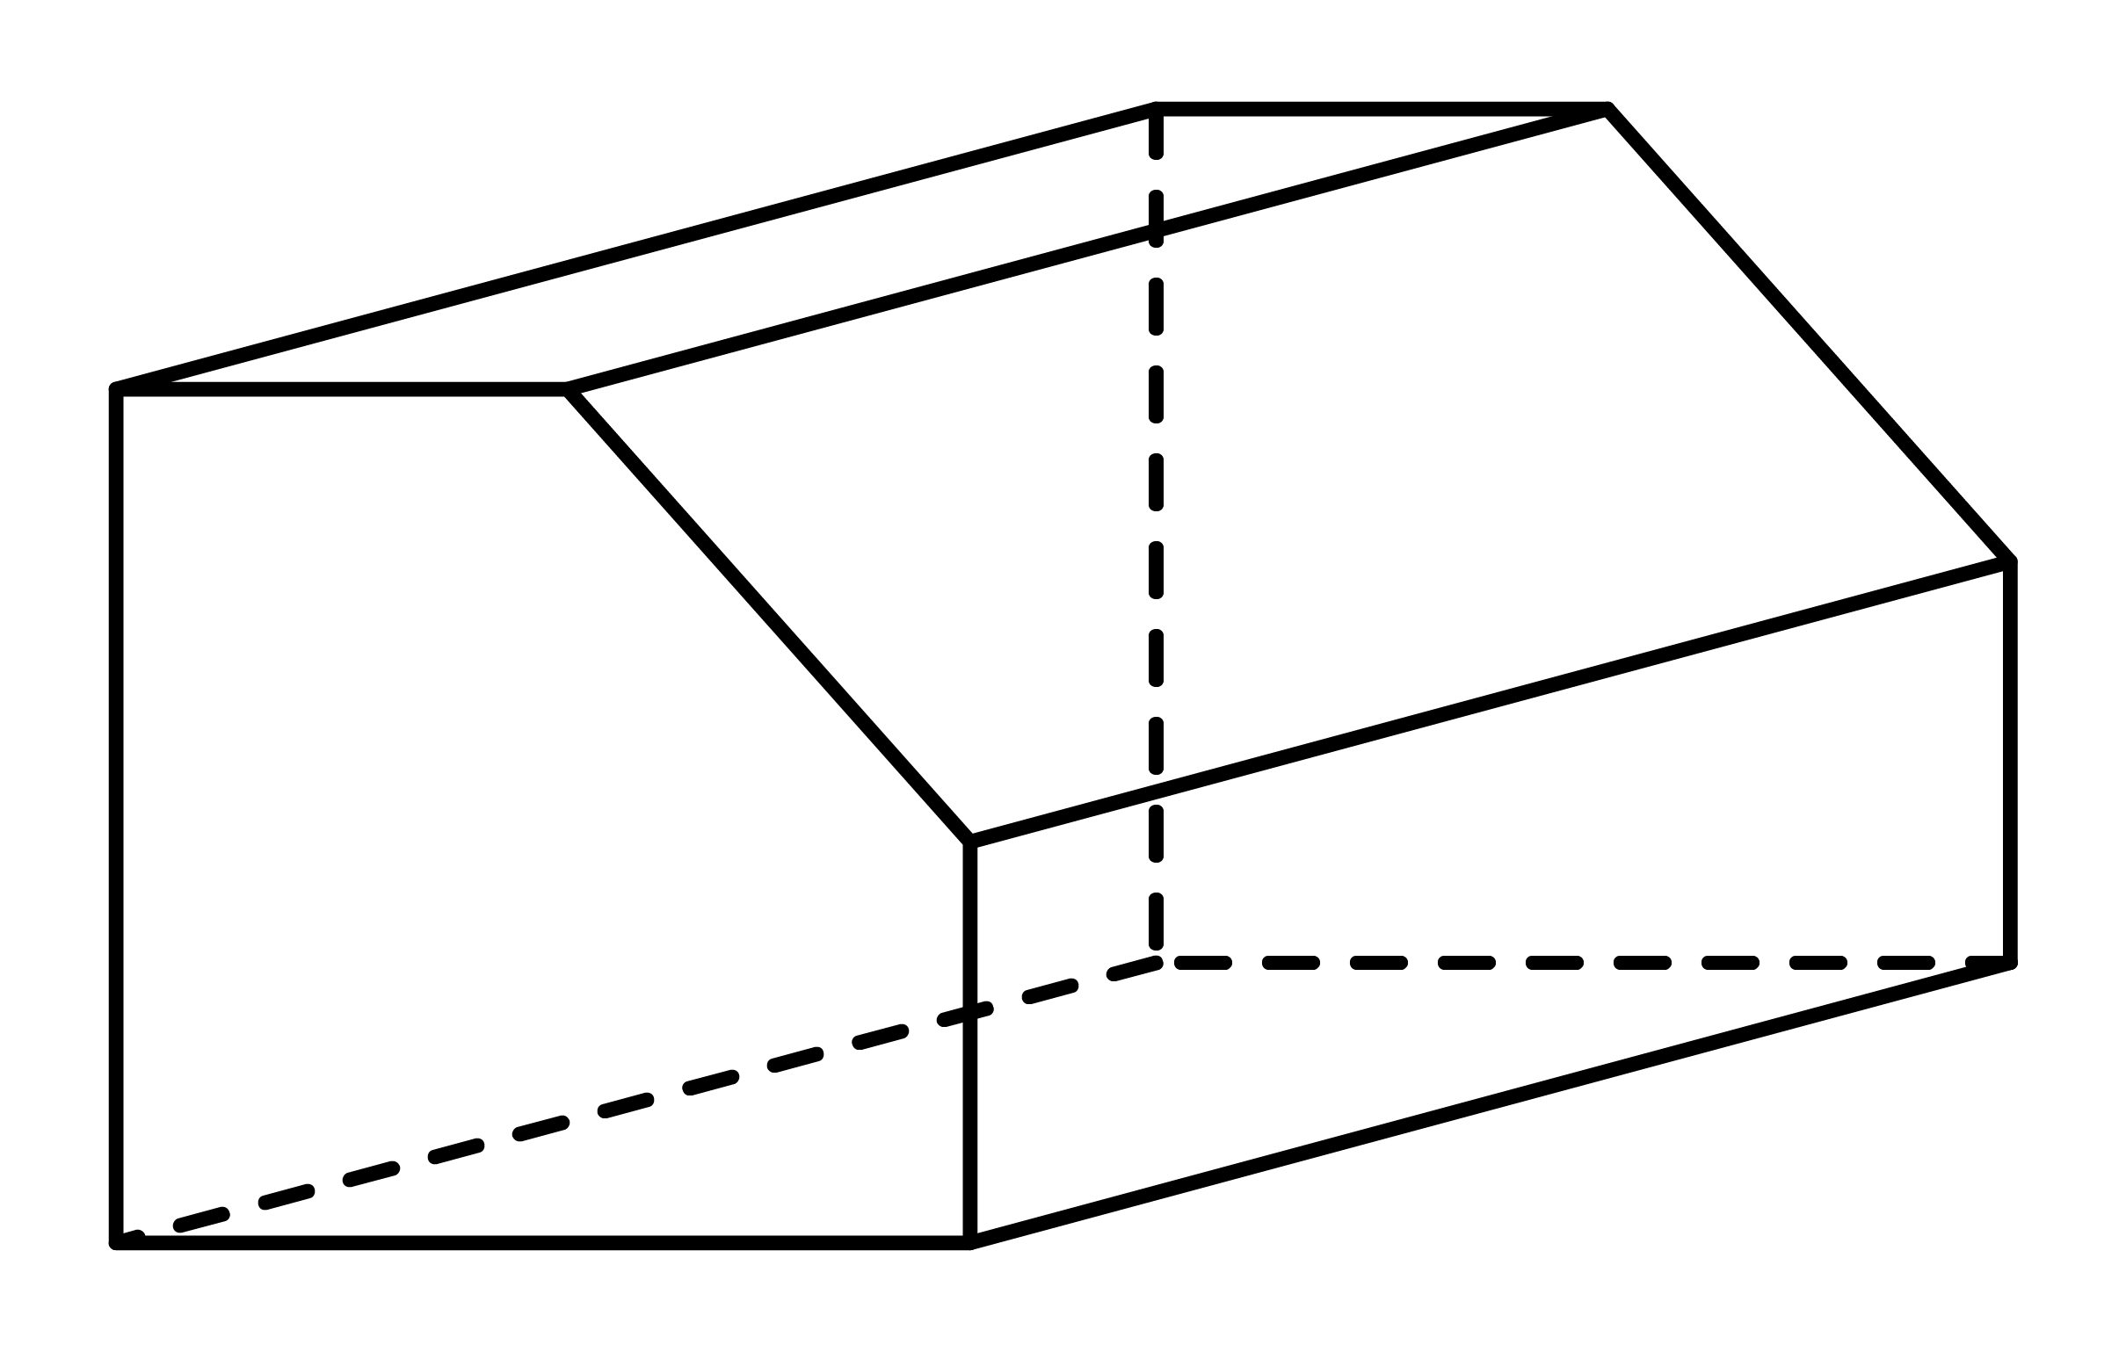
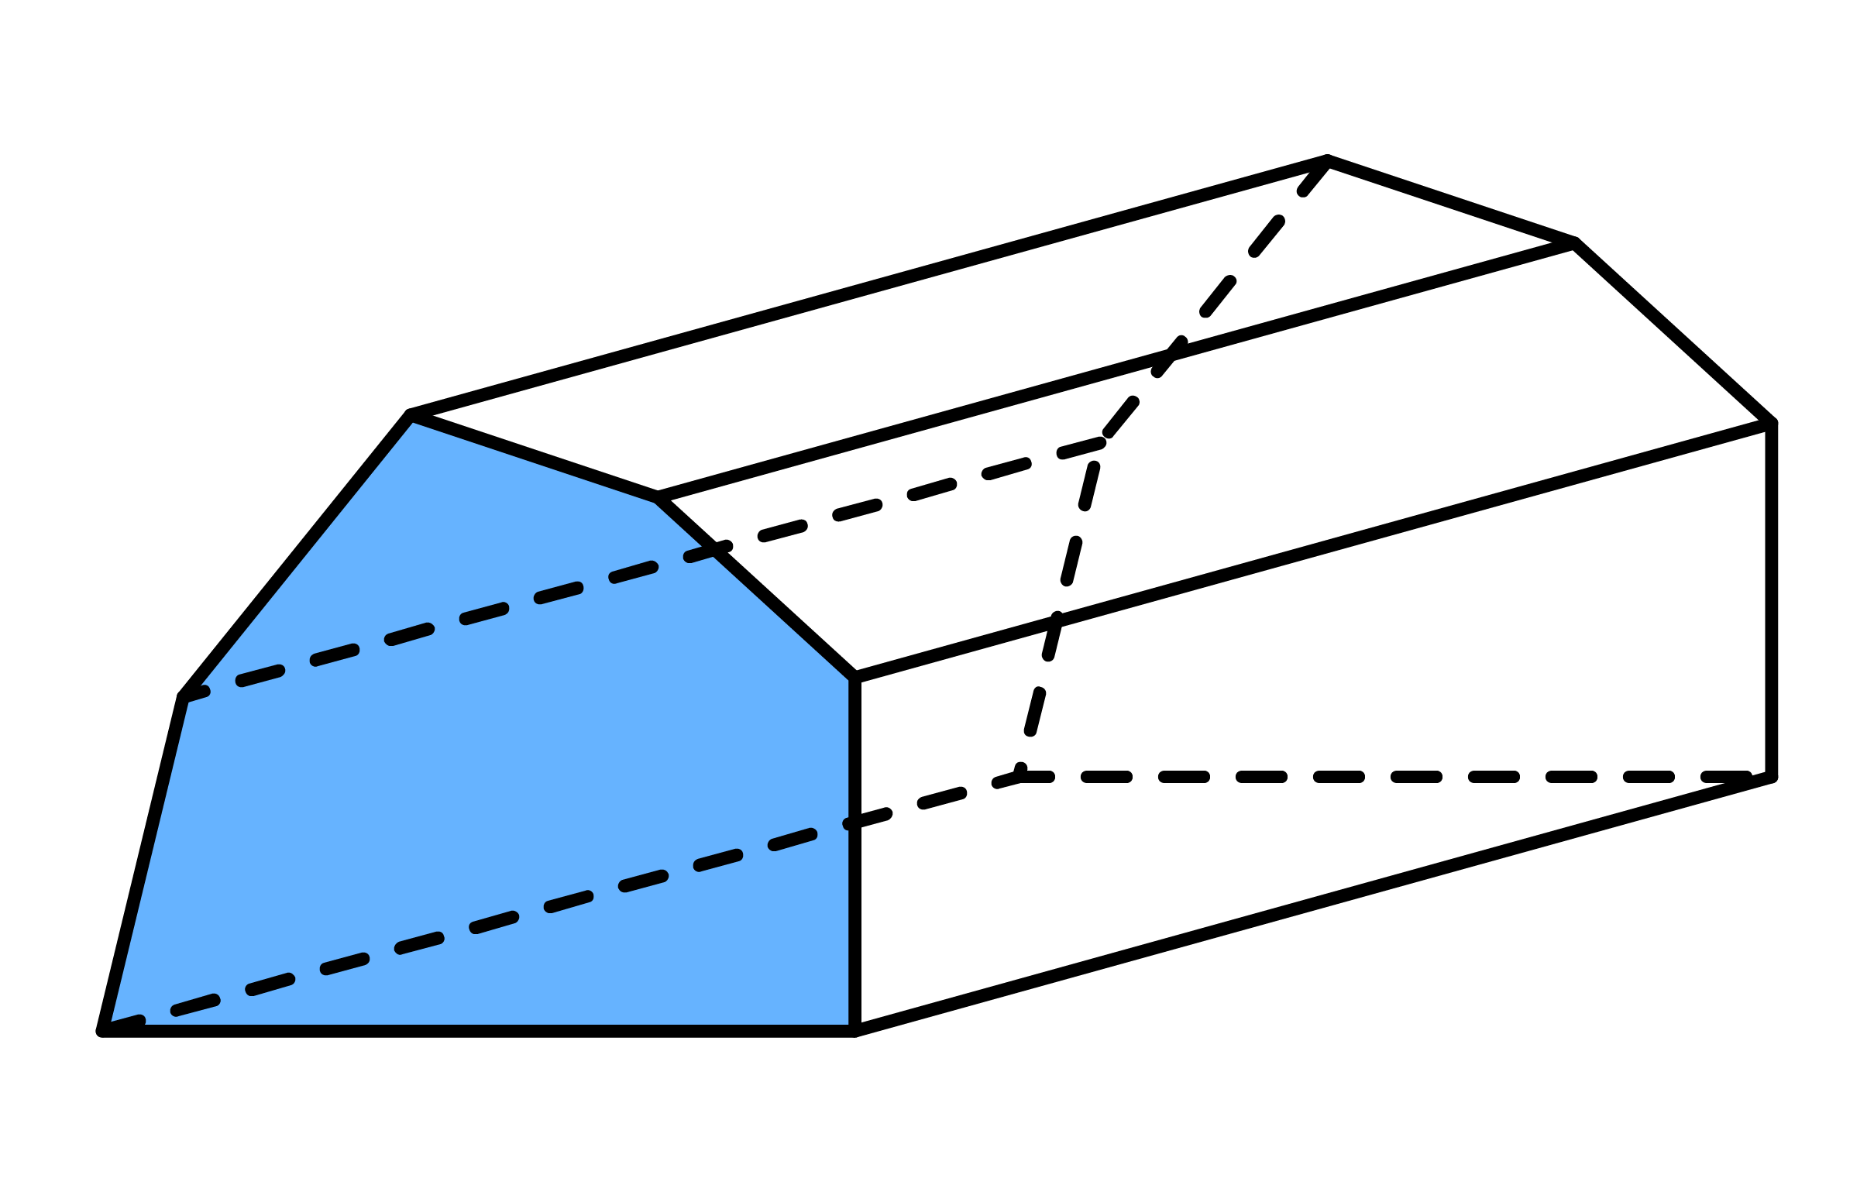
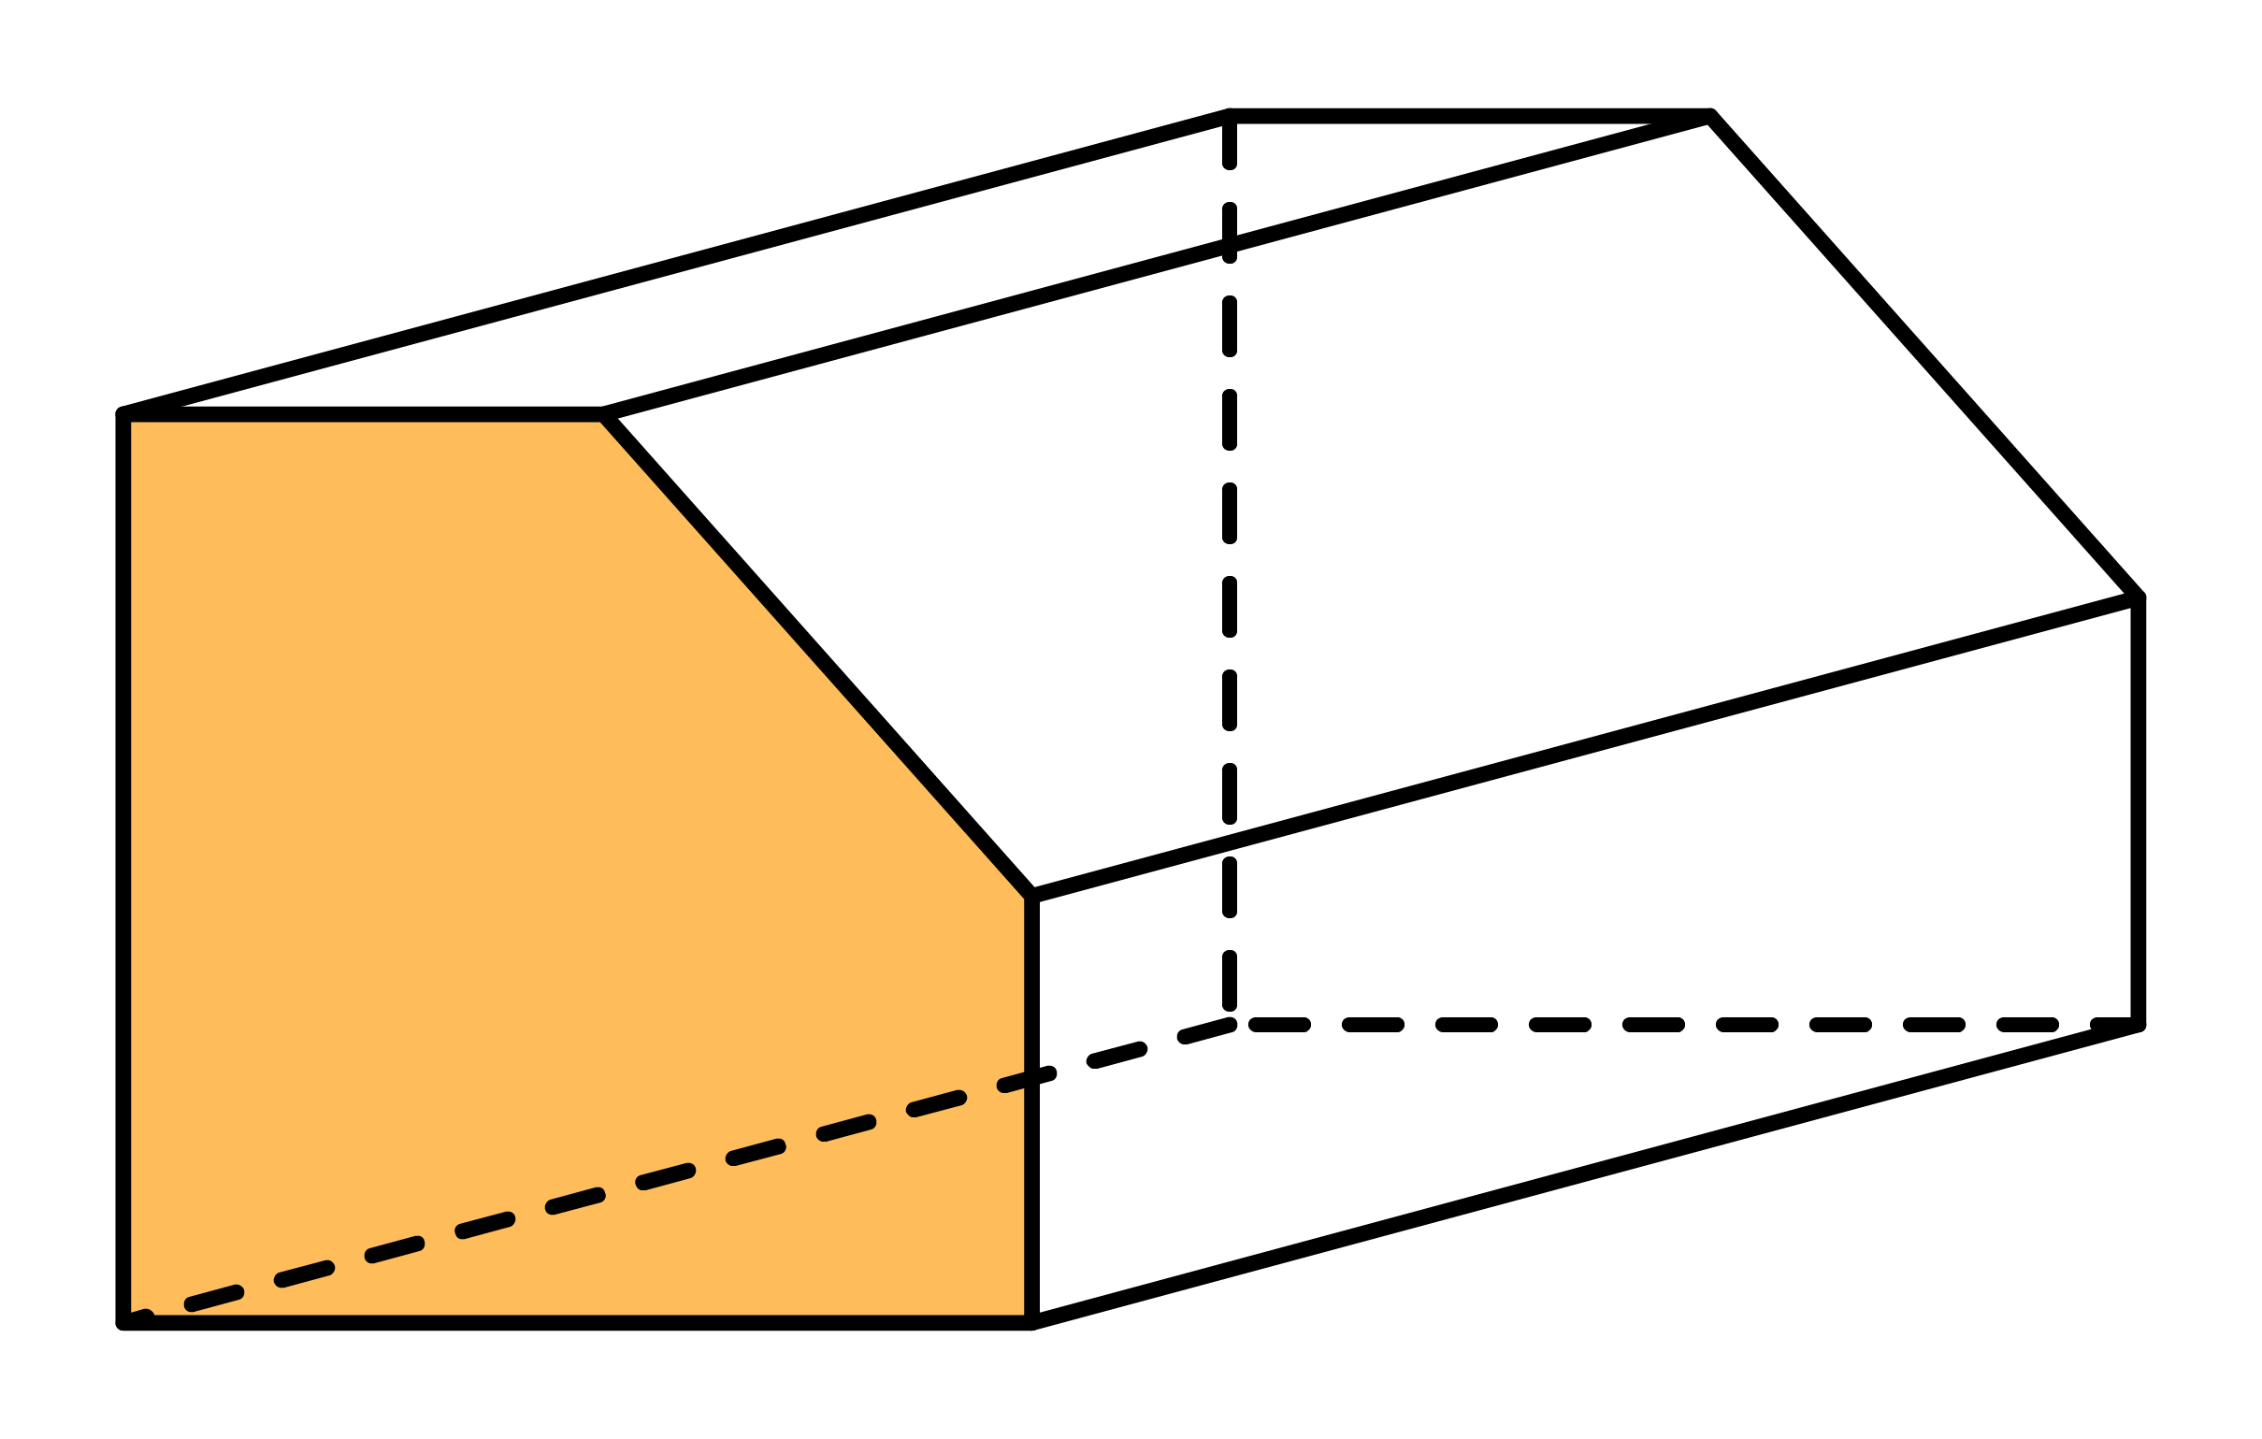
Before finding the volume of a prism, you first have to identify its cross-section and its length.
Ex1
Shade the cross section and label the length for each of the following prisms.
Solution
Length
Length
Length
Length
Length

Slide 4
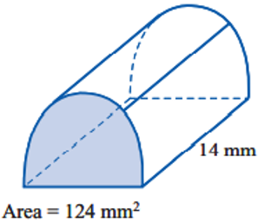
Whiteboards
Diagram
Rule:
Numbers:
Solve:

Slide 5
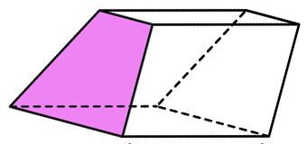

Calculate volume
$${Area= 14cm}^{2}$$
Diagram
Rule:
Numbers:
Solve:
Length = 3.5m

Slide 6
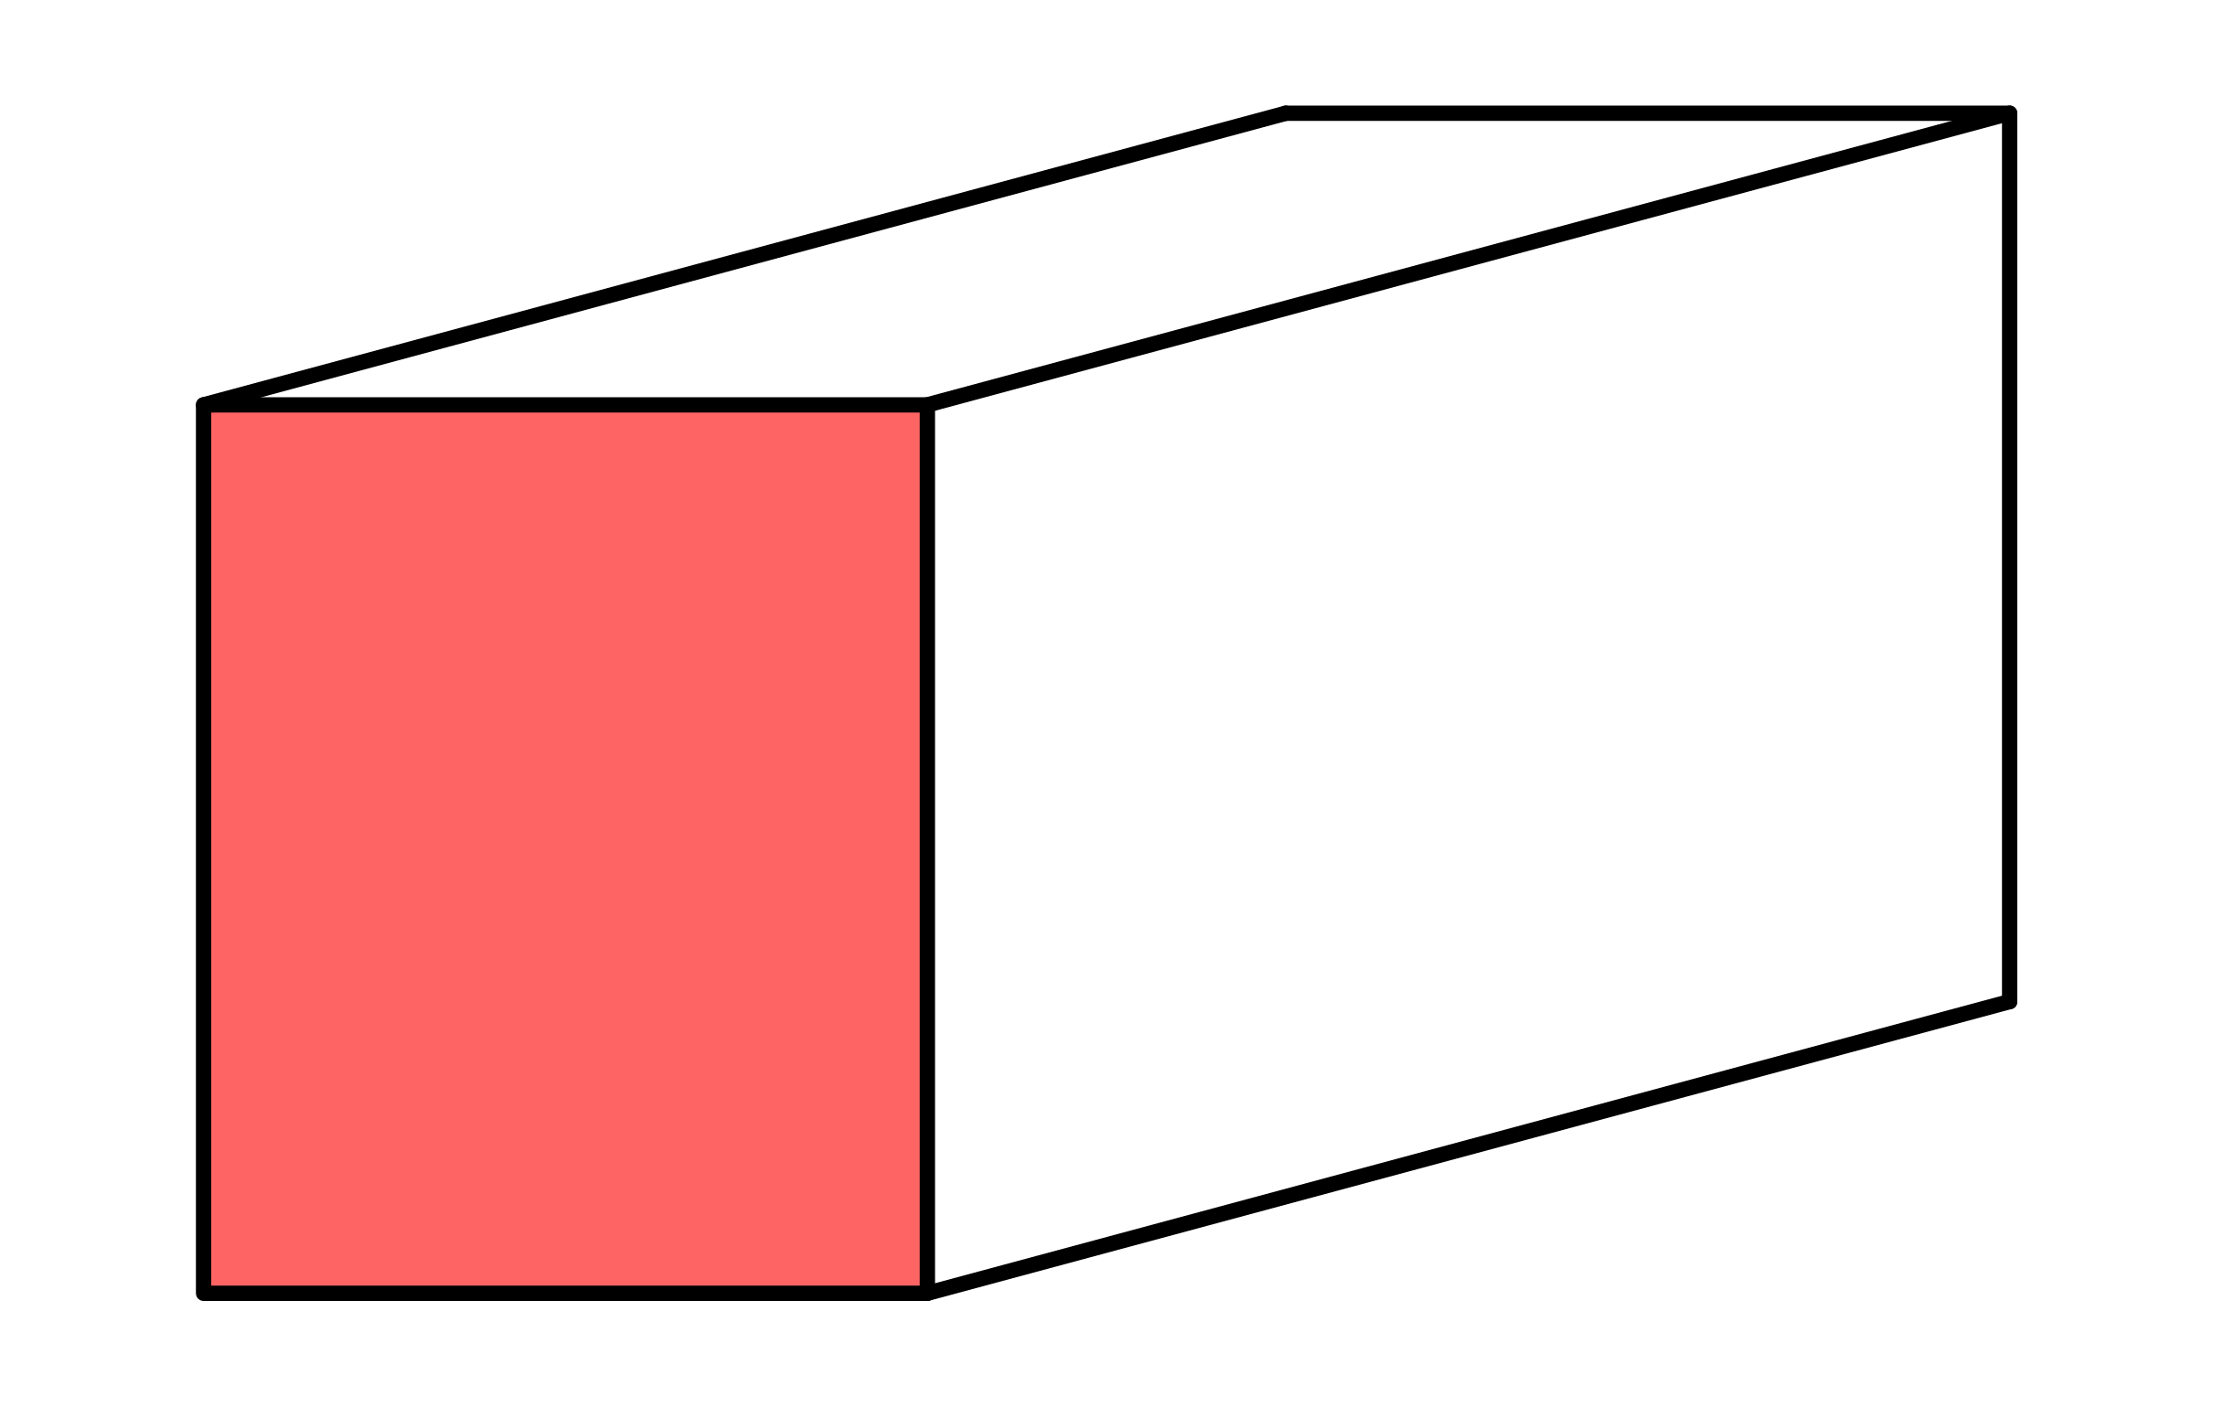
Whiteboards
Diagram
Rule:
Numbers:
Solve:
10mm
3cm
16mm

Slide 7
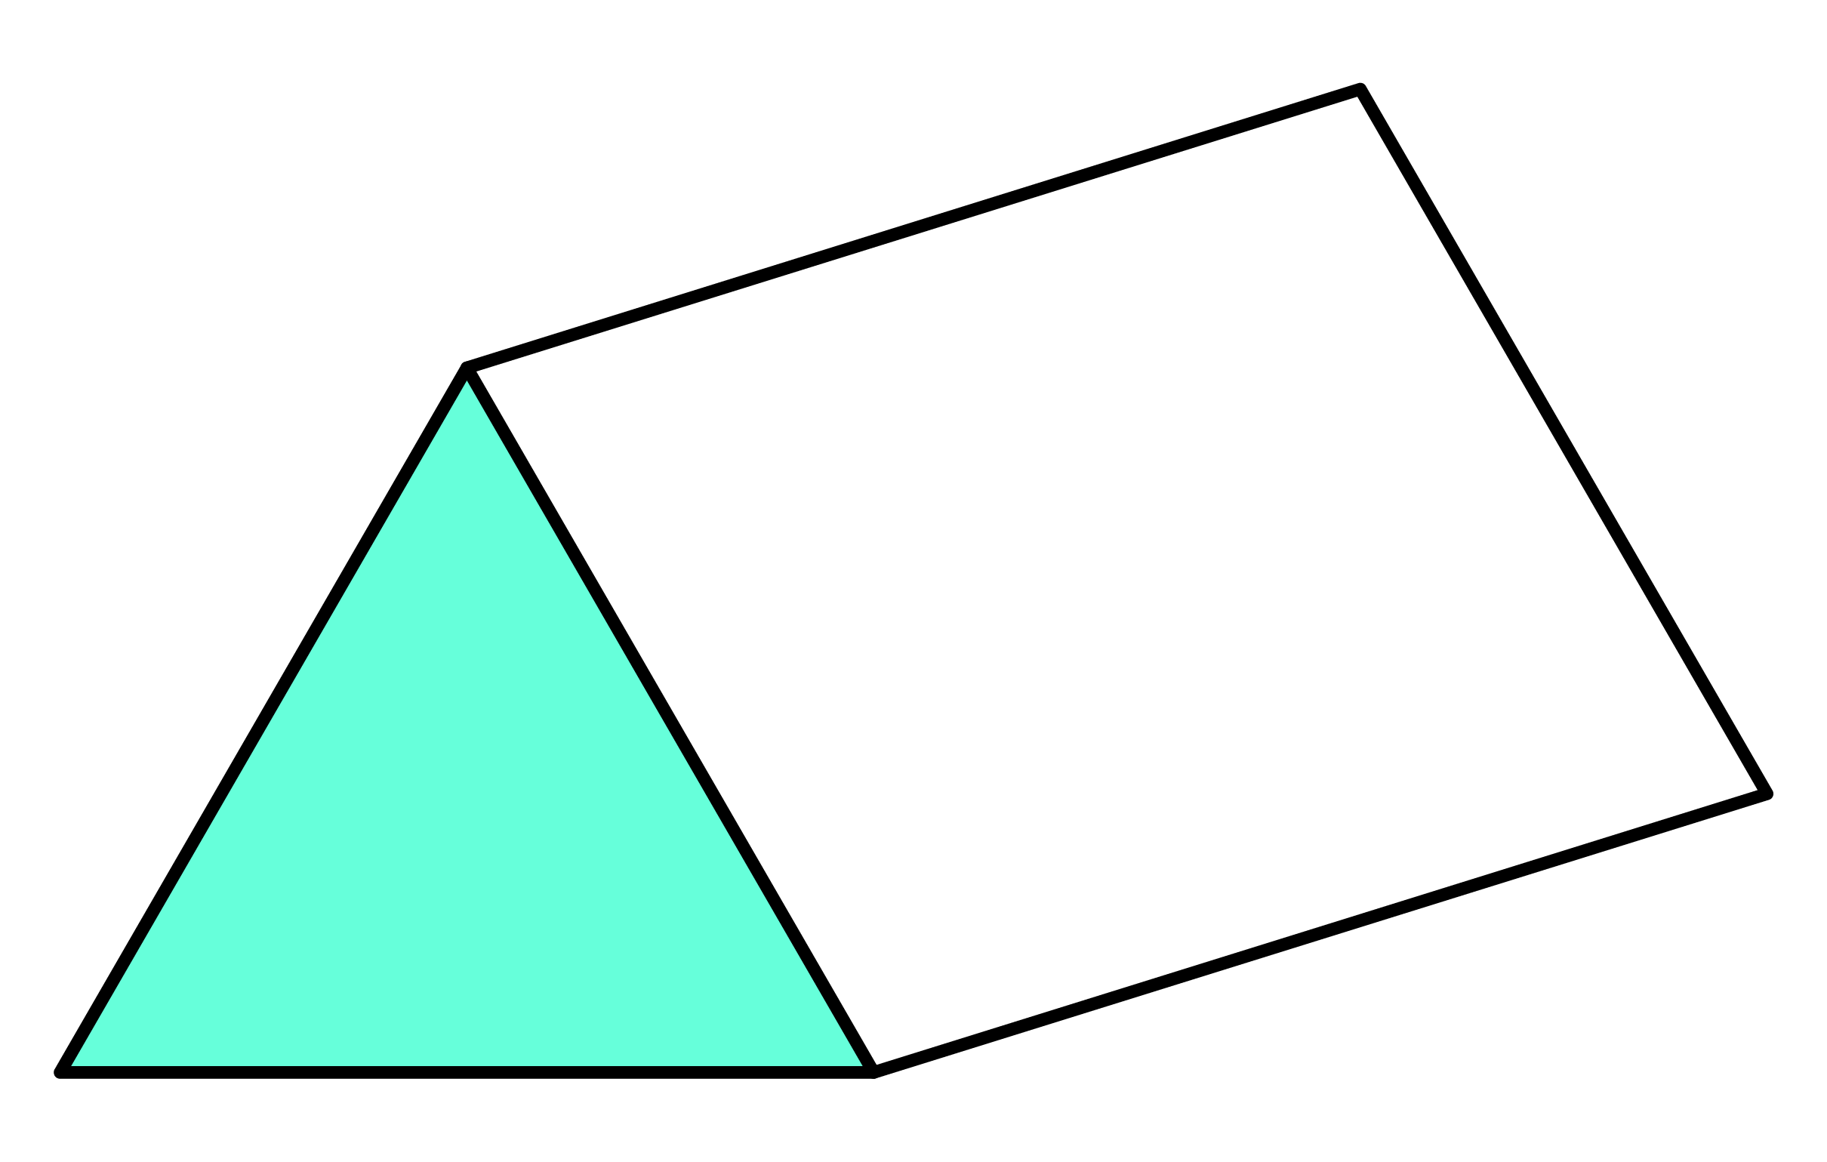
Whiteboards
Diagram
Rule:
Numbers:
Solve:
5m
8m
10m
5.2m

Slide 8
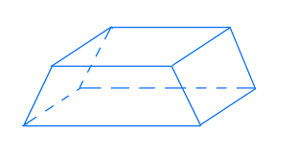
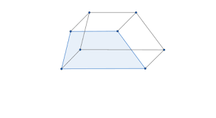

Trapezium prism
5cm
I do
3cm
What’s the rule?
R: V $=\frac{\left(a+b\right)}{2} ×h ×l$
N:
S:
8cm
11cm
You do
4cm
6cm
5cm
8cm

Slide 9
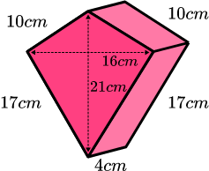

Kite prism
D:
R: $V= \frac{a×b }{2}×l$
N
S:

Slide 10
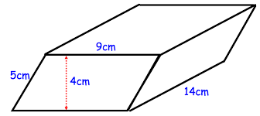

Parallelogram prism
D:
R: $V=b×h×l$
N:
S:
How much water can this hold?

Slide 11
Conversion flow chart

Slide 12
Individual practice
Cross-section puzzle
Excel sheet.

